Slide 1


Representation Learning for Word, Sense, Phrase, Document and Knowledge
Natural Language Processing Lab, Tsinghua University
Yu Zhao, Xinxiong Chen, Yankai Lin, Yang Liu
Zhiyuan Liu, Maosong Sun

Slide 2




Contributors
Yu Zhao
Xinxiong Chen
Yankai Lin
Yang Liu

Slide 3
ML = Representation + Objective + Optimization

Slide 4
Good Representation is Essential for
Good Machine Learning

Slide 5

Representation
Learning
Machine Learning
Systems
Raw Data
Yoshua Bengio. Deep Learning of Representations. AAAI 2013 Tutorial.

Slide 6
NLP Tasks: Tagging/Parsing/Understanding
Document Representation
Knowledge Representation
Phrase Representation
Sense Representation
Word Representation
Unstructured Text

Slide 7
NLP Tasks: Tagging/Parsing/Understanding
Document Representation
Knowledge Representation
Phrase Representation
Sense Representation
Word Representation
Unstructured Text

Slide 8

Typical Approaches for Word Representation
1-hot representation: basis of bag-of-word model
star
[0, 0, 0, 0, 0, 0, 0, 0, 1, 0, 0, 0, 0, …]
sun
[0, 0, 0, 0, 0, 0, 0, 1, 0, 0, 0, 0, 0, …]
sim(star, sun) = 0

Slide 9
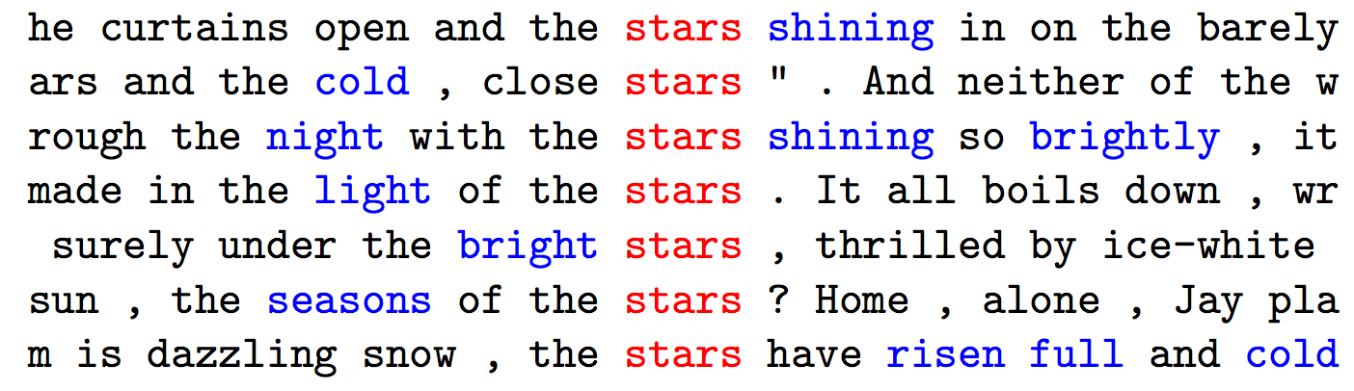

Typical Approaches for Word Representation
Count-based distributional representation
Notes:
Issues:
(1) Involves a large number of design choices (what weighting scheme? what similarity measure?)
(2) Going from word to sentence representations is non-trivial, and no clear intuitions exist.

Slide 10
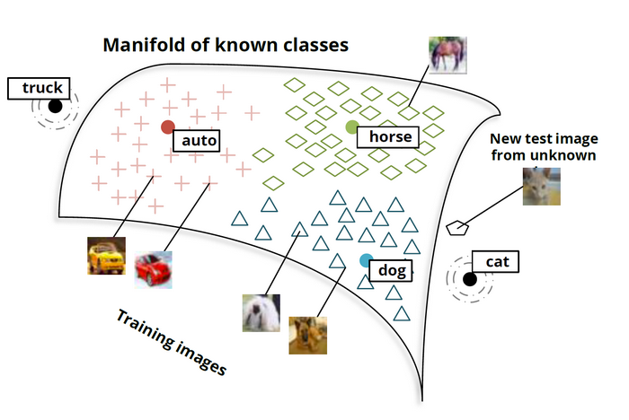
Distributed Word Representation
Each word is represented as a dense and real-valued vector in a low-dimensional space

Slide 11
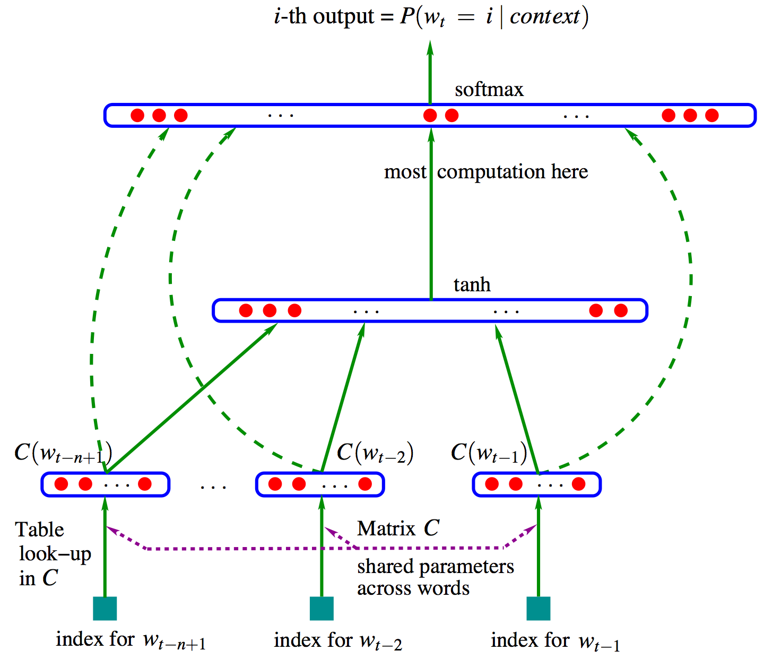
Typical Models of Distributed Representation
Neural
Language
Model
Yoshua Bengio. A neural probabilistic language model. JMLR 2003.

Slide 12
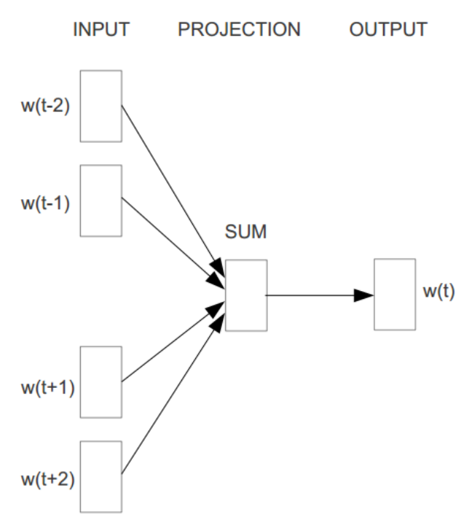
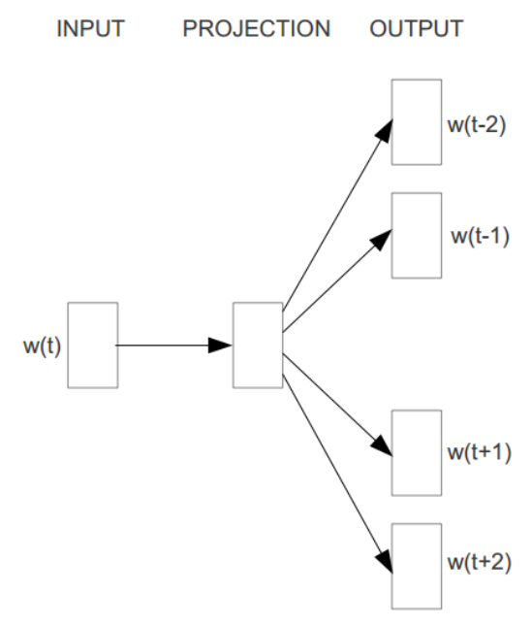
Typical Models of Distributed Representation
word2vec
Tomas Mikolov et al. Distributed representations of words and phrases and their compositionality. NIPS 2003.

Slide 13
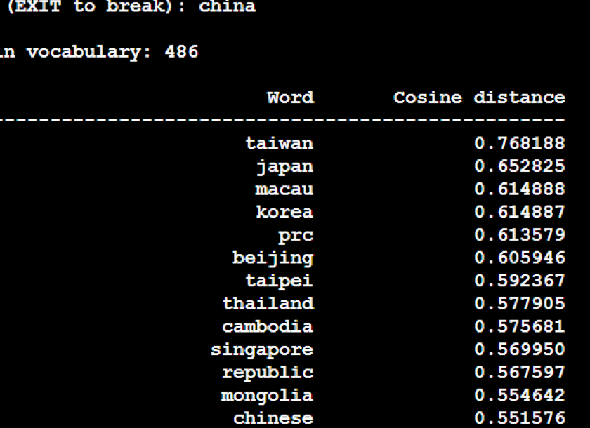
Word Relatedness

Slide 14
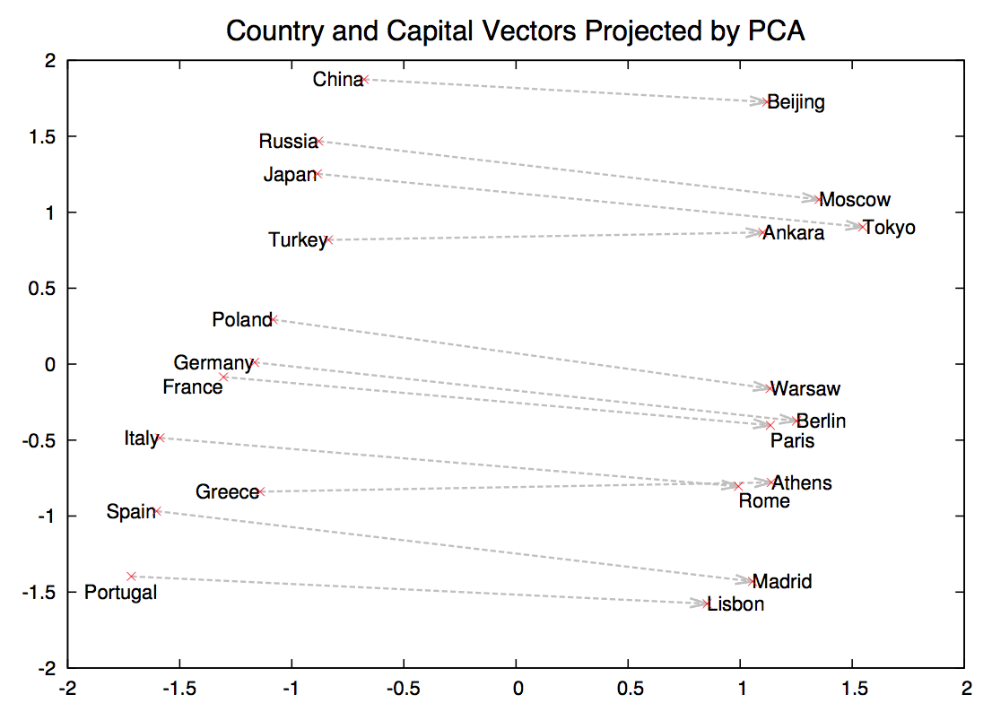
Semantic Space Encode Implicit Relationships between Words
W(‘‘China“) − W(‘‘Beijing”) ≃ W(‘‘Japan“) − W(‘‘Tokyo")

Slide 15
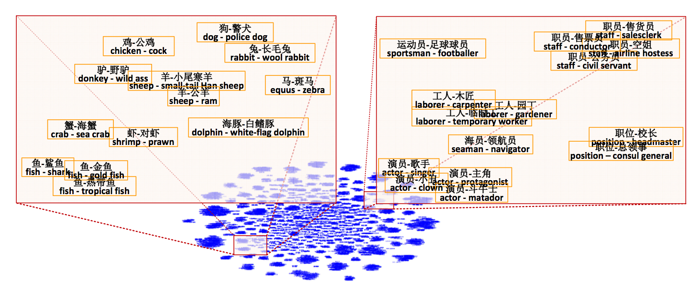
Applications: Semantic Hierarchy Extraction
Fu, Ruiji, et al. Learning semantic hierarchies via word embeddings. ACL 2014.

Slide 16
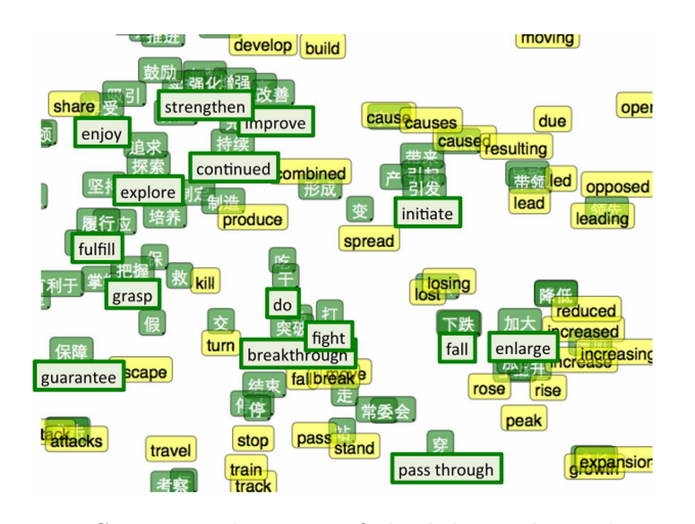
Applications: Cross-lingual Joint Representation
Zou, Will Y., et al. Bilingual word embeddings for phrase-based machine translation. EMNLP 2013.

Slide 17
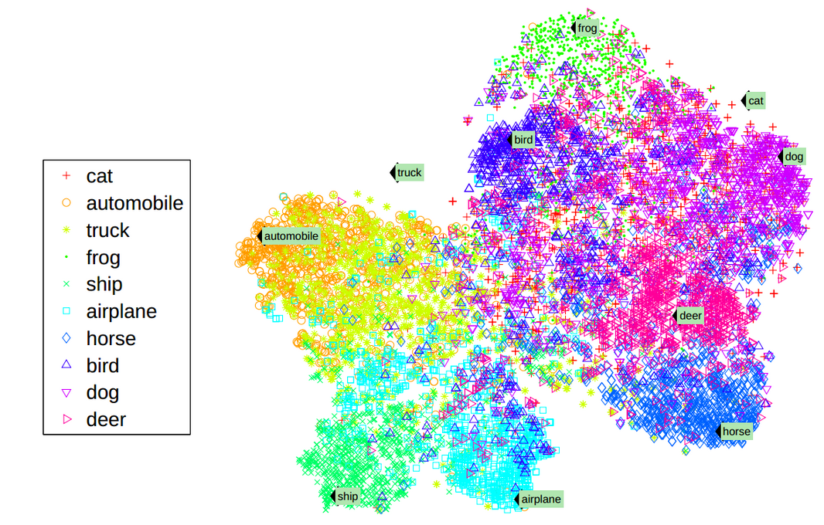
Applications: Visual-Text Joint Representation
Richard Socher, et al. Zero-Shot Learning Through Cross-Modal Transfer. ICLR 2013.

Slide 18
Re-search, Re-invent
word2vec ≃ MF
Neural Language Models
Distributional Representation
SVD
Levy and Goldberg. Neural word embedding as implicit matrix factorization. NIPS 2014.

Slide 19
NLP Tasks: Tagging/Parsing/Understanding
Document Representation
Knowledge Representation
Phrase Representation
Sense Representation
Word Representation
Unstructured Text

Slide 20
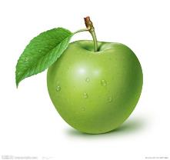


Word Sense Representation
Apple

Slide 21
Multiple Prototype Methods
J. Reisinger and R. Mooney. Multi-prototype vector-space models of word meaning. HLT-NAACL 2010.
E Huang, et al. Improving word representations via global context and multiple word prototypes. ACL 2012.

Slide 22
Nonparametric Methods
Neelakantan et al. Efficient Non-parametric Estimation of Multiple Embeddings per Word in Vector Space. EMNLP 2014.

Slide 23

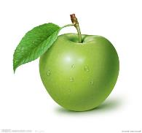
Joint Modeling of WSD and WSR
WSD
?
?
WSR
Jobs Founded Apple
Chen Xinxiong, et al. A Unified Model for Word Sense Representation and Disambiguation. EMNLP 2014.

Slide 24
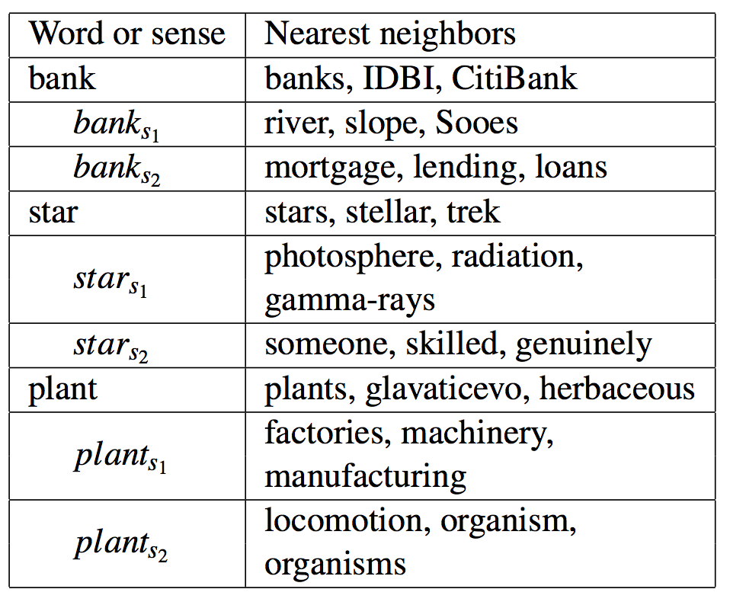
Joint Modeling of WSD and WSE

Slide 25
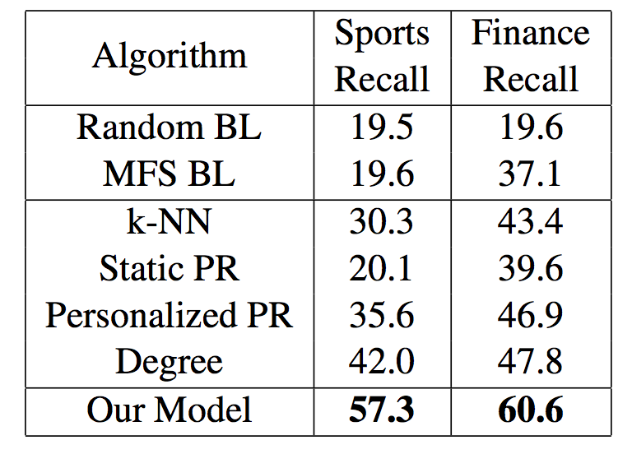
Joint Modeling of WSD and WSE
WSD on Two Domain Specific Datasets

Slide 26
NLP Tasks: Tagging/Parsing/Understanding
Document Representation
Knowledge Representation
Phrase Representation
Sense Representation
Word Representation
Unstructured Text

Slide 27
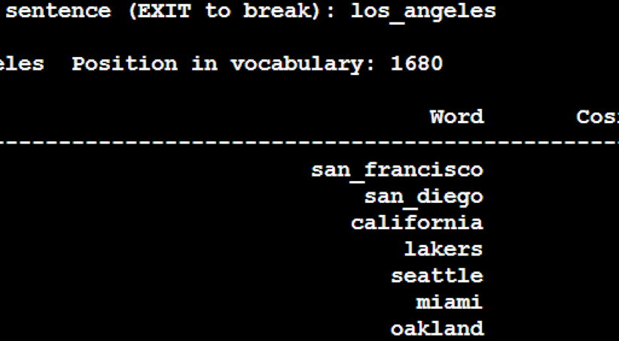
Phrase Representation
For high-frequency phrases, learn phrase representation by regarding them as pseudo words: Log Angeles ➔ log_angeles
Many phrases are infrequent and many new phrases generate
We build a phrase representation from its words based on the semantic composition nature of languages

Slide 28

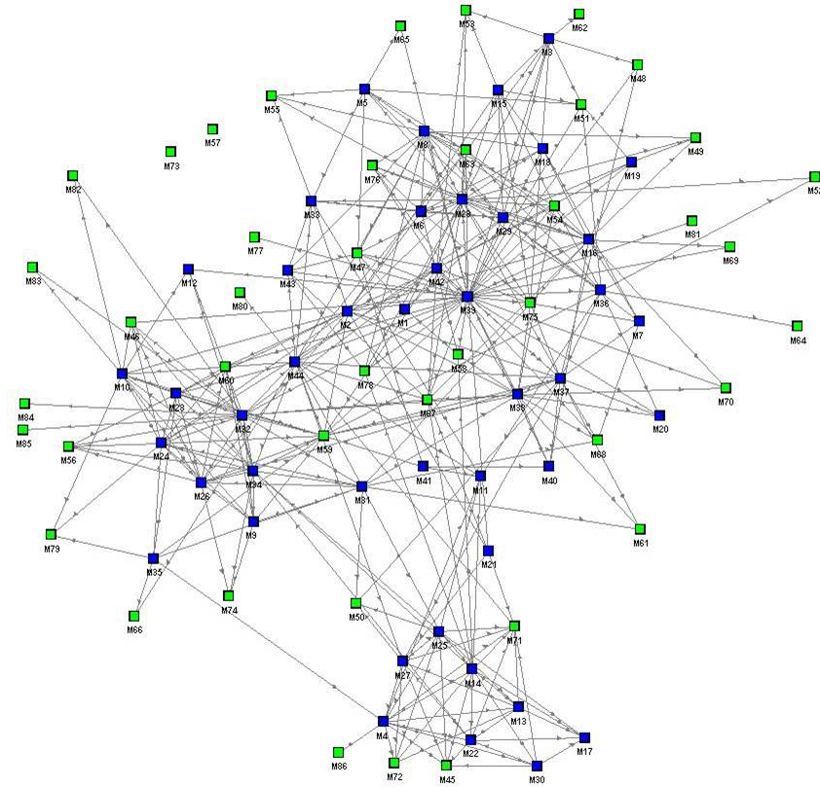
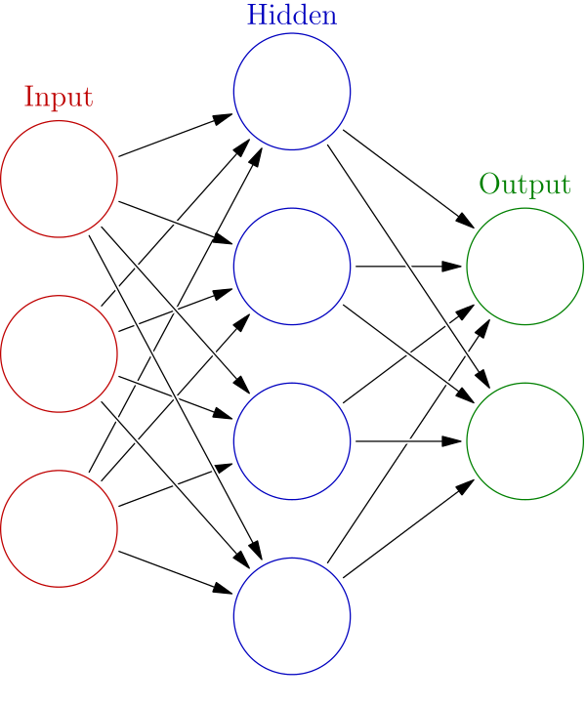
Semantic Composition for Phrase Represent.
+
neural
network
neural network
Notes:
28

Slide 29
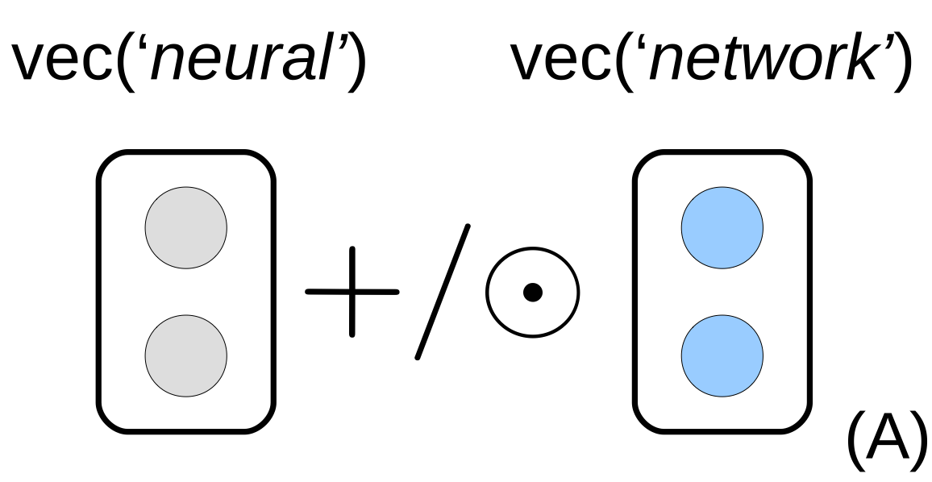
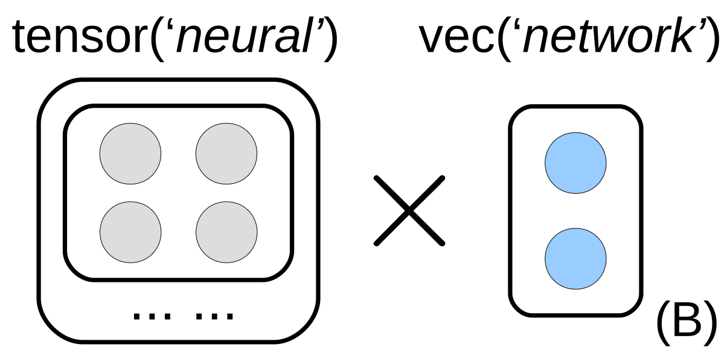
Semantic Composition for Phrase Represent.
Heuristic Operations
Tensor-Vector Model
Zhao Yu, et al. Phrase Type Sensitive Tensor Indexing Model for Semantic Composition. AAAI 2015.

Slide 30
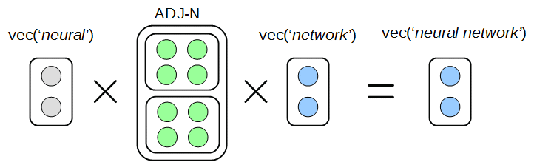
Semantic Composition for Phrase Represent.
Model Parameters

Slide 31
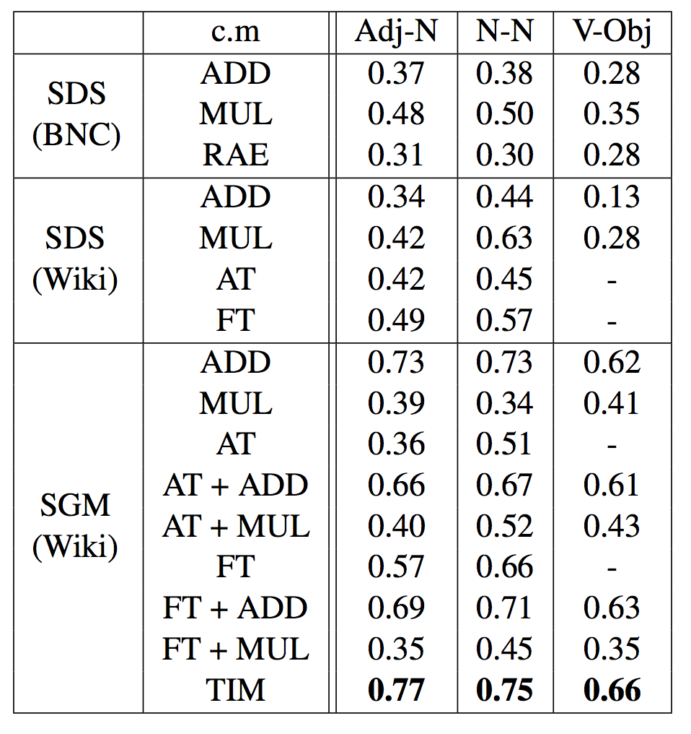
Evaluation with Phrase Similarity
Evaluation on phrase similarity
Compare system ranking with human judgment via spearman correlation coefficient
Our model (Tensor Index Model, TIM) achieves best correlation

Slide 32
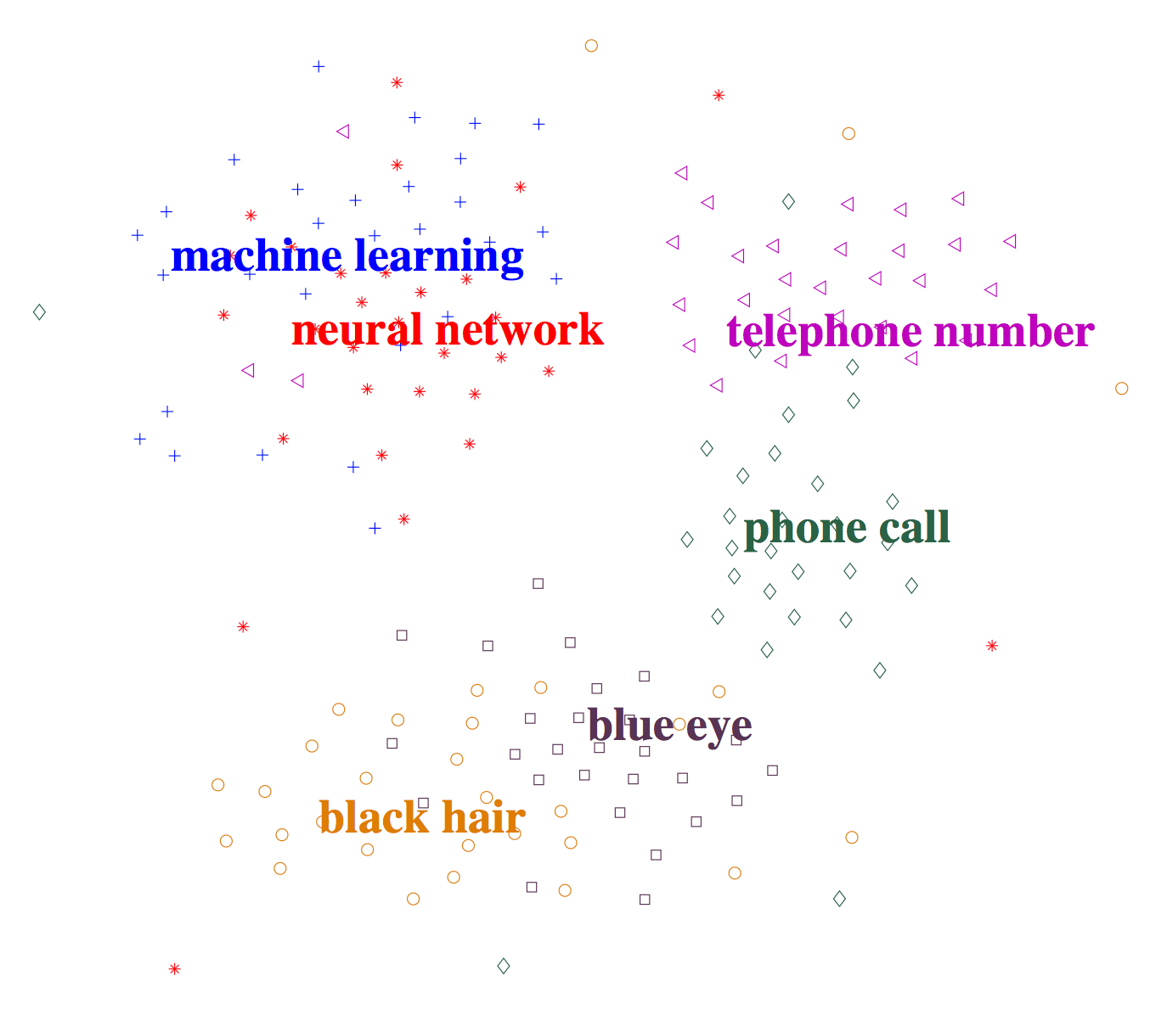
Visualization for Phrase Representation

Slide 33
NLP Tasks: Tagging/Parsing/Understanding
Document Representation
Knowledge Representation
Phrase Representation
Sense Representation
Word Representation
Unstructured Text

Slide 34
Document as Symbols for DR

Slide 35
Semantic Composition for DR: CNN

Slide 36
Semantic Composition for DR: RNN

Slide 37
Document Representation Models
Replicated Softmax: an Undirected Topic Model (NIPS 2010)
A Deep Architecture for Matching Short Texts (NIPS 2013)
Modeling Documents with a Deep Boltzmann Machine (UAI 2013)
A Convolutional Neural Network for Modeling Sentences (ACL 2014)
Distributed Representations of Sentences and Documents (ICML 2014)
Convolutional Neural Network Architectures for Matching Natural Language Sentences (NIPS 2014)

Slide 38
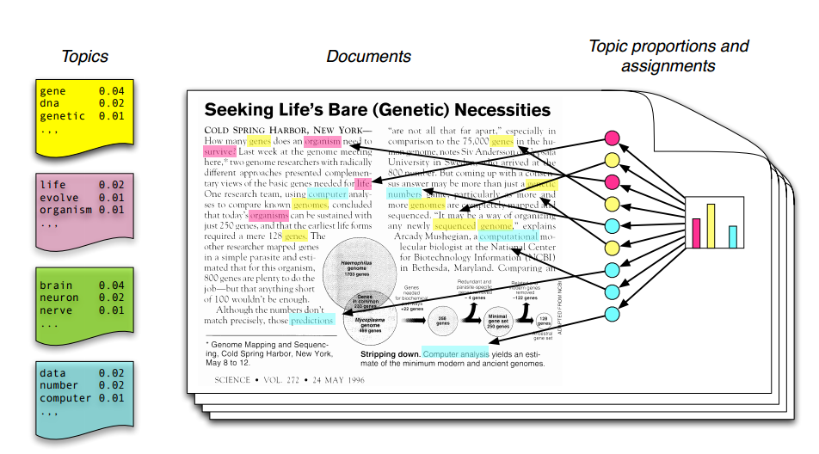
Topic Model
Collapsed Gibbs Sampling
Assign each word in a document with an approximately topic

Slide 39
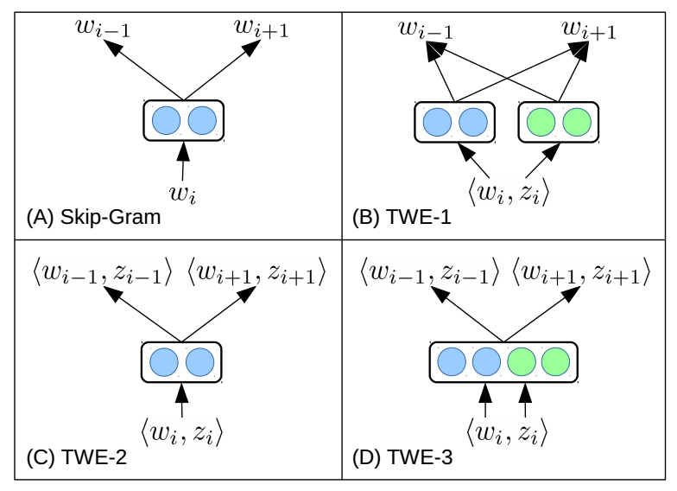
Topical Word Representation
Liu Yang, et al. Topical Word Embeddings. AAAI 2015.

Slide 40
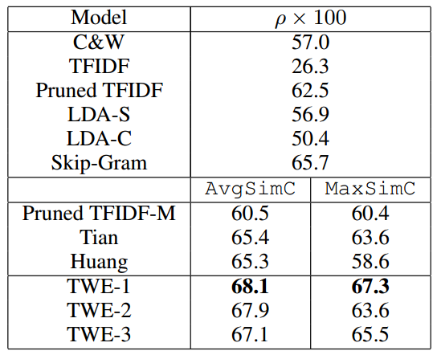
Context-Aware Word Similarity
Measure word similarities in specific contexts
SCWS: 2, 003 pairs of words with contexts

Slide 41
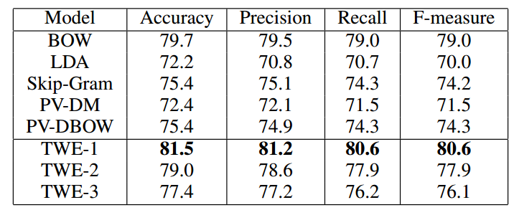
Text Classification
Multi-class text classification on 20NewsGroup (20K docs)

Slide 42
NLP Tasks: Tagging/Parsing/Understanding
Document Representation
Knowledge Representation
Phrase Representation
Sense Representation
Word Representation
Unstructured Text

Slide 43
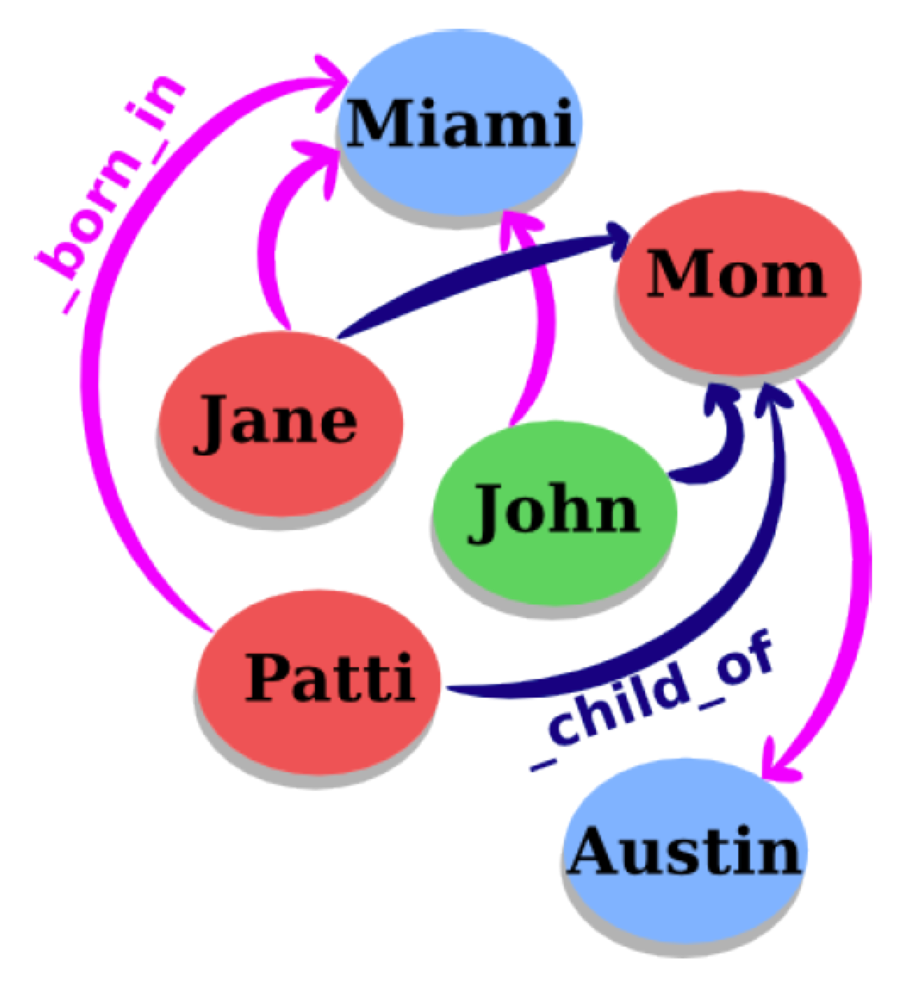
Knowledge Bases and Knowledge Graphs
Knowledge is structured as a graph
Each node = an entity
Each edge = a relation
A relation = (head, relation, tail):
head = subject entity
relation = relation type
tail = object entity
Typical knowledge bases
WordNet: Linguistic KB
Freebase: World KB

Slide 44
Research Issues
KG is far from complete, we need relation extraction
Relation extraction from text: information extraction
Relation extraction from KG: knowledge graph completion
Issues: KGs are hard to manipulate
High dimensions: 10^5~10^8 entities, 10^7~10^9 relation types
Sparse: few valid links
Noisy and incomplete
How: Encode KGs into low-dimensional vector spaces

Slide 45
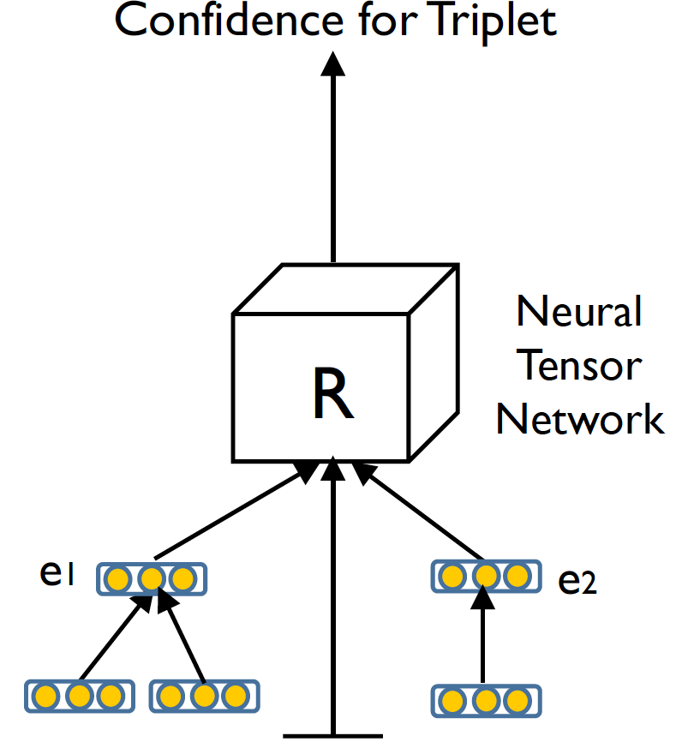
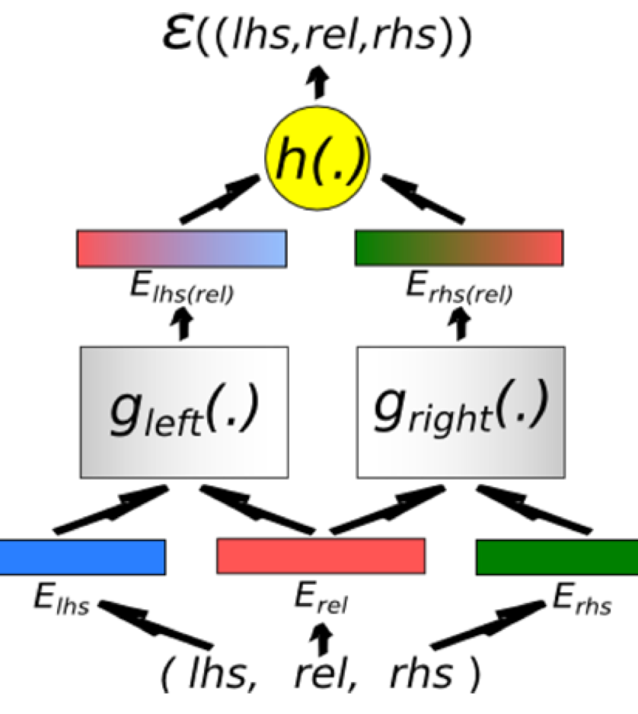
Typical Models - NTN
Neural Tensor Network (NTN)
Energy Model

Slide 46
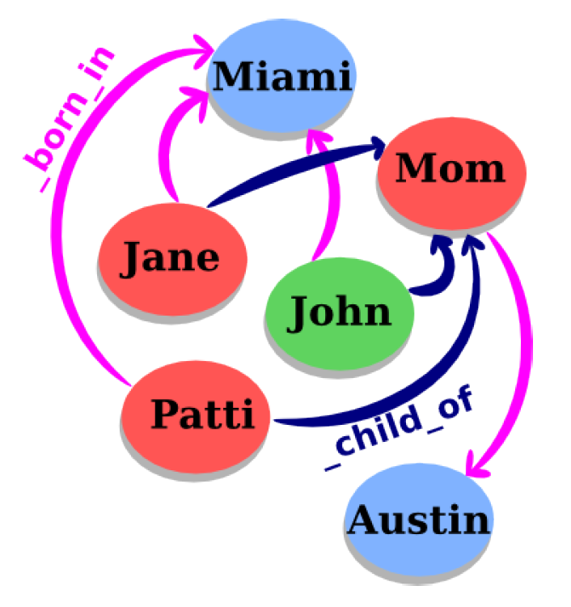
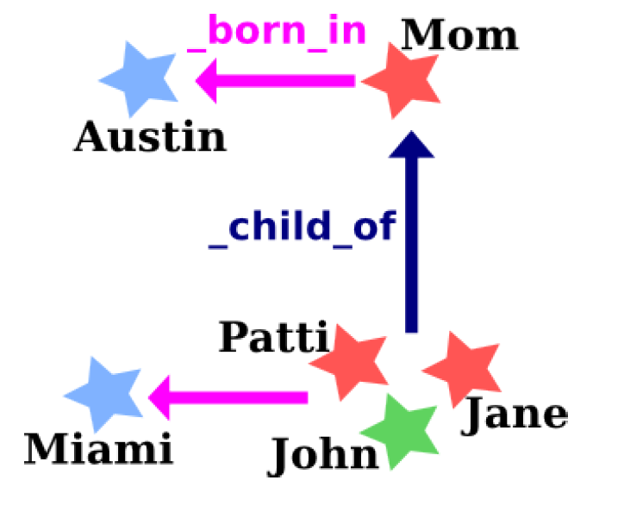
TransE: Modeling Relations as Translations
For each (head, relation, tail), relation works as a translation from head to tail

Slide 47
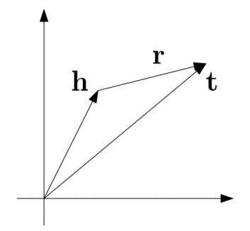
TransE: Modeling Relations as Translations
For each (head, relation, tail), make h + r = t

Slide 48
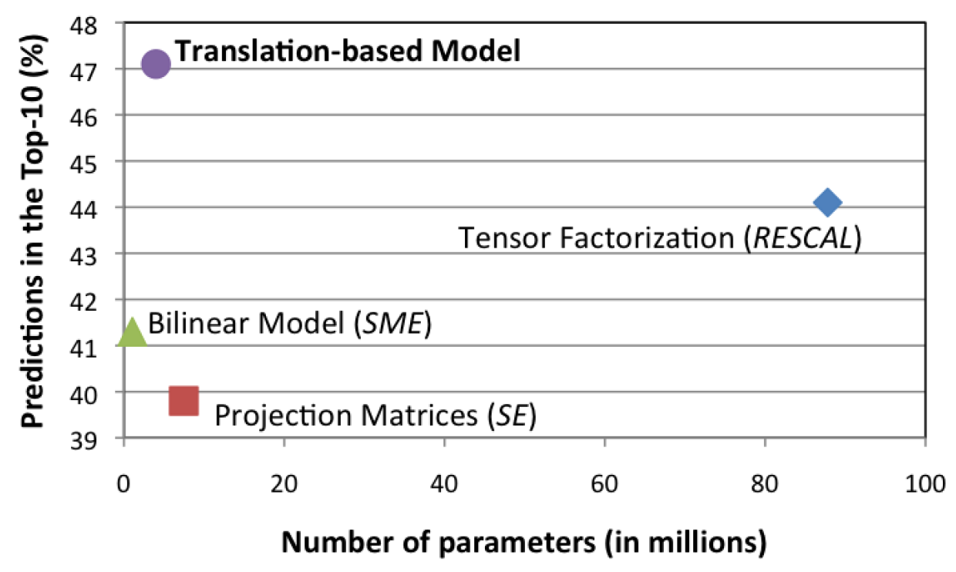
Link Prediction Performance
On Freebase15K:

Slide 49
The Issue of TransE
Have difficulties for modeling many-to-many relations

Slide 50
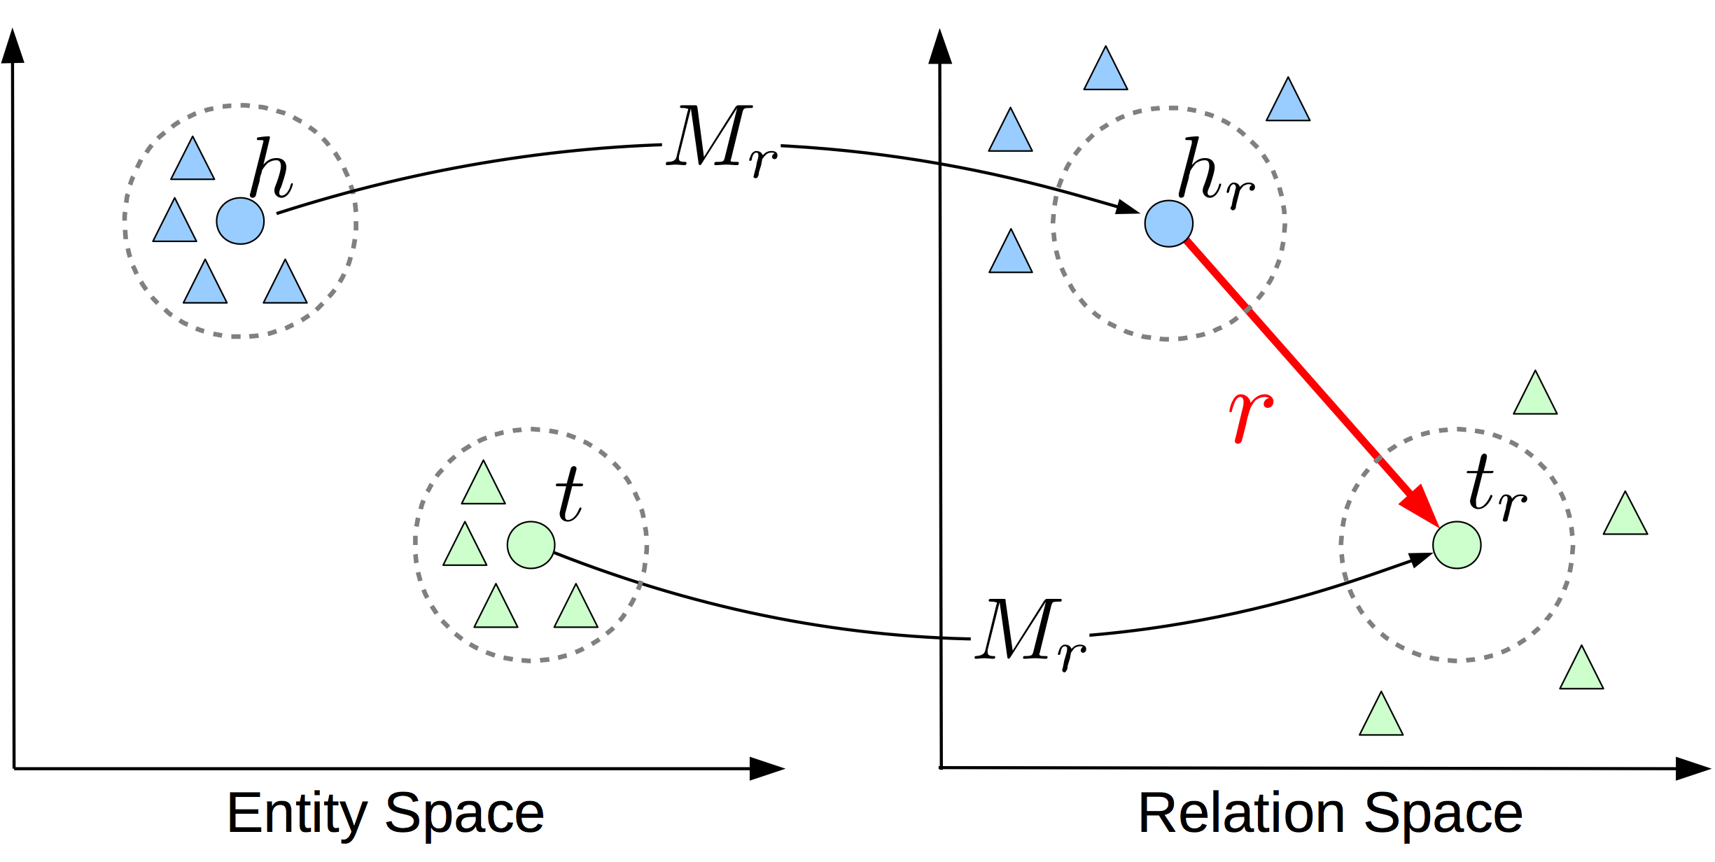
Modeling Entities/Relations in Different Space
Encode entities and relations in different space, and use relation-specific matrix to project
Lin Yankai, et al. Learning Entity and Relation Embeddings for Knowledge Graph Completion. AAAI 2015.

Slide 51
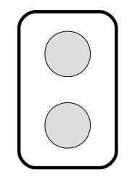
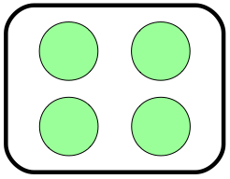
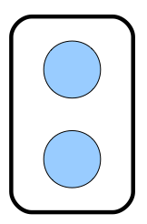
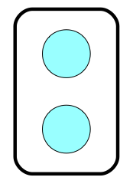
Modeling Entities/Relations in Different Space
For each (head, relation, tail), make h x W_r + r = t x W_r
head
relation
tail
+
=

Slide 52
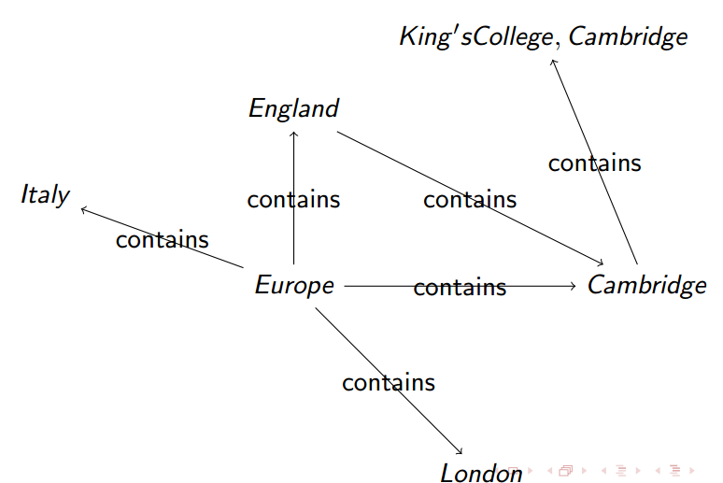
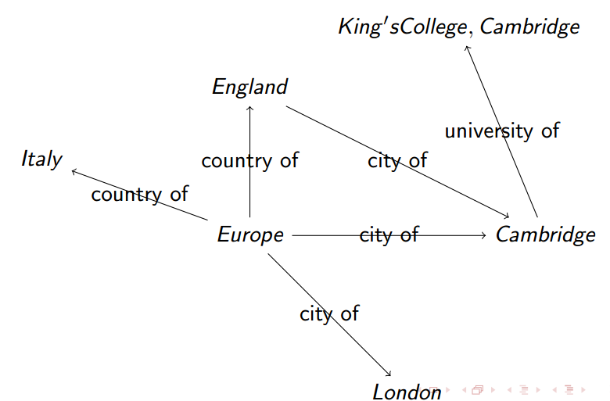
Cluster-based TransR (CTranR)

Slide 53

Evaluation: Link Prediction
Which genre is the movie WALL-E?
WALL-E _has_genre ?

Slide 54
Evaluation: Link Prediction
Which genre is the movie WALL-E?
WALL-E _has_genre
Animation
Computer animation
Comedy film
Adventure film
Science Fiction
Fantasy
Stop motion
Satire
Drama
Connecting

Slide 55
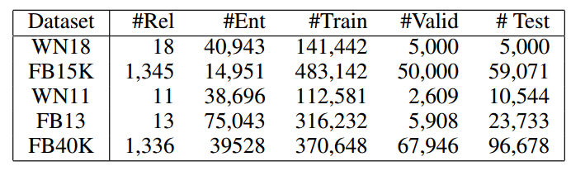
Evaluation Datasets

Slide 56
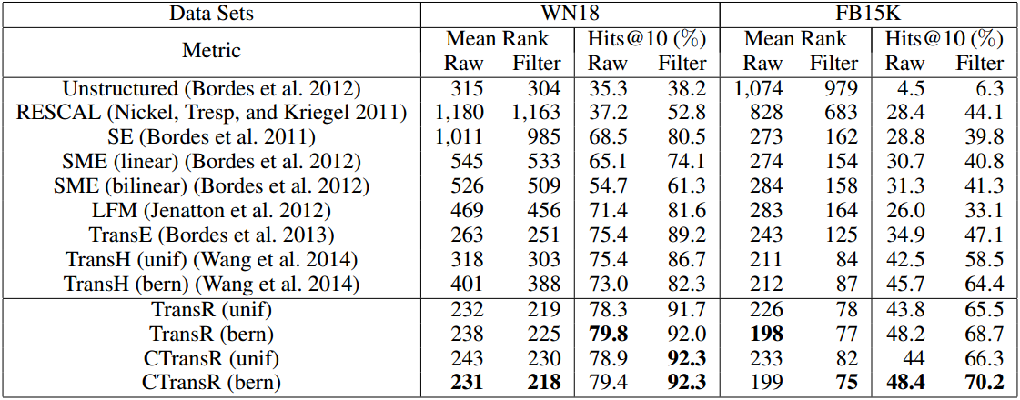
Performance

Slide 57
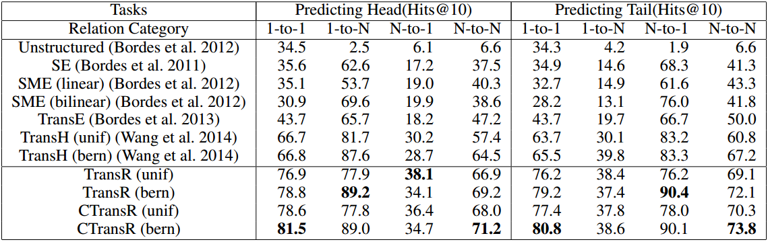
Performance (FB15K)

Slide 58
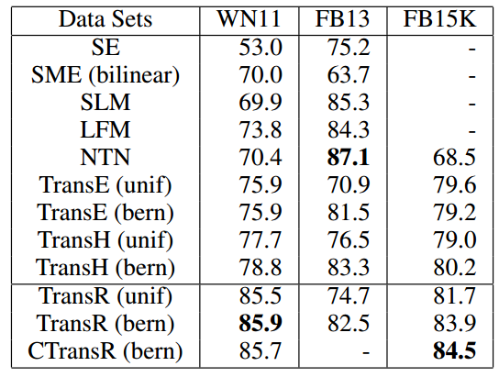
Performance on Triple Classification

Slide 59
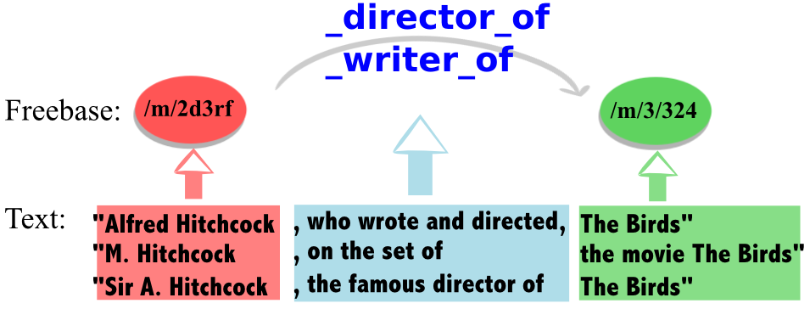
Research Challenge: KG + Text for RL
Incorporate KG embeddings with text-based relation extraction

Slide 60
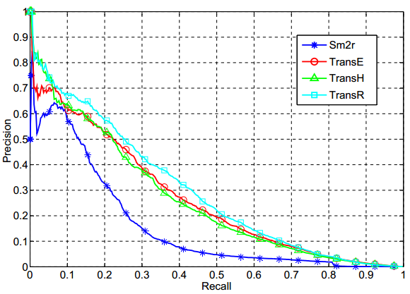
Power of KG + Text for RL

Slide 61
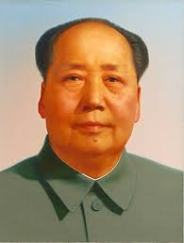
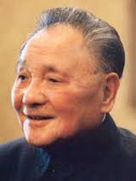
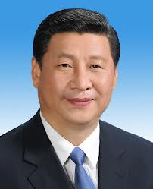
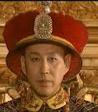


Research Challenge: Relation Inference
Current models consider each relation independently
There are complicate correlations among these relations
predecessor
predecessor
father
father
predecessor
grandfather

Slide 62
Reference
Learning Structured Embeddings of Knowledge Bases. A. Bordes, J. Weston, R. Collobert & Y. Bengio. AAAI, 2011.
Joint Learning of Words and Meaning Representations for Open-Text Semantic Parsing. A. Bordes, X. Glorot, J. Weston & Y. Bengio. AISTATS, 2012.
A Latent Factor Model for Highly Multi-relational Data. R. Jenatton, N. Le Roux, A. Bordes & G. Obozinski. NIPS, 2012.
A Semantic Matching Energy Function for Learning with Multi-relational Data. A. Bordes, X. Glorot, J. Weston & Y. Bengio. MLj, 2013.
Irreflexive and Hierarchical Relations as Translations. A. Bordes, N. Usunier, A. Garcia-Duran, J. Weston & O. Yakhnenko. ICML Workshop on Structured Learning, 2013

Slide 63
NLP Tasks: Tagging/Parsing/Understanding
Document Representation
Knowledge Representation
Phrase Representation
Sense Representation
Word Representation
Unstructured Text

Slide 64
Take Home Message
Distributed representation is a powerful tool to model semantics of entries in a dense low-dimensional space
Distributed representation can be used
as pre-training of deep learning
to build features of machine learning tasks, especially multi-task learning
as a unified model to integrate heterogeneous information (text, image, …)
Distributed representation has been used for modeling word, sense, phrase, document, knowledge, social network, text/images, etc..
There are still many open issues
Incorporation of prior human knowledge
Representation of complicated structure (trees, network paths)

Slide 65
Everything Can be Embedded (given context). (Almost) Everything Should be Embedded.

Slide 66
Publications
Xinxiong Chen, Zhiyuan Liu, Maosong Sun. A Unified Model for Word Sense Representation and Disambiguation. The Conference on Empirical Methods in Natural Language Processing (EMNLP'14).
Yu Zhao, Zhiyuan Liu, Maosong Sun. Phrase Type Sensitive Tensor Indexing Model for Semantic Composition. The 29th AAAI Conference on Artificial Intelligence (AAAI'15).
Yang Liu, Zhiyuan Liu, Tat-Seng Chua, Maosong Sun. Topical Word Embeddings. The 29th AAAI Conference on Artificial Intelligence (AAAI'15).
Yankai Lin, Zhiyuan Liu, Maosong Sun, Yang Liu, Xuan Zhu. Learning Entity and Relation Embeddings for Knowledge Graph Completion. The 29th AAAI Conference on Artificial Intelligence (AAAI'15).

Slide 67
Thank You!
More Information: http://nlp.csai.tsinghua.edu.cn/~lzy
Email: liuzy@tsinghua.edu.cn

